Slide 1

Unravel Earth
Your journey to Utopia

Slide 2

MOTIVATION
We have always loved traveling and exploring new places, cultures, and cuisines. But We also know how hard it can be to plan a trip, especially when you have limited time, budget, or information. That's why We decided to create my own travel website, where We share my personal experiences and recommendations for various destinations around the world. My goal is to help other travelers find the best places to visit, stay, eat, and enjoy, based on their preferences and needs. We also provide tips and tricks on how to save money, avoid scams, and make the most of your trip. My website is not just a collection of reviews or ratings, but a curated guide that reflects my honest opinions and insights. We hope you find it useful and inspiring for your next adventure

Slide 3

About Us
Unravel Earth is a passionate team of travel enthusiasts committed to making your journeys extraordinary
Our mission is to offer a seamless and personalized travel planning experience, ensuring every trip is as unique as the traveler

Slide 4

The Power of Recommendations
Enhancing Your Journey
Personalized recommendations are the heart of , elevating your travel experience
By leveraging cutting-edge technology, we transform the way you plan and embark on your adventures, making it more efficient and enjoyable

Slide 5
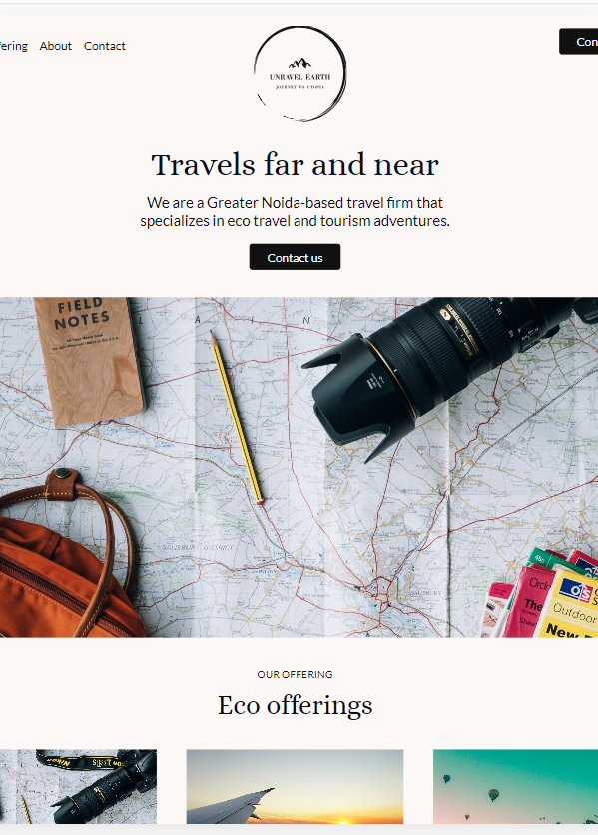
How Recommendations Work
Behind the Scenes
Our recommendation engine combines advanced algorithms and user preferences to generate tailor-made suggestions
Behind the scenes, powerful technology analyzes vast amounts of data to provide you with the most relevant and personalized recommendations

Slide 6

User Benefits
Your Journey, Your Way
Experience the benefits of personalized recommendations
Save time with efficient trip planning
Enjoy tailored itineraries that match your preferences
Increase satisfaction by discovering hidden gems and personalized experiences

Slide 7
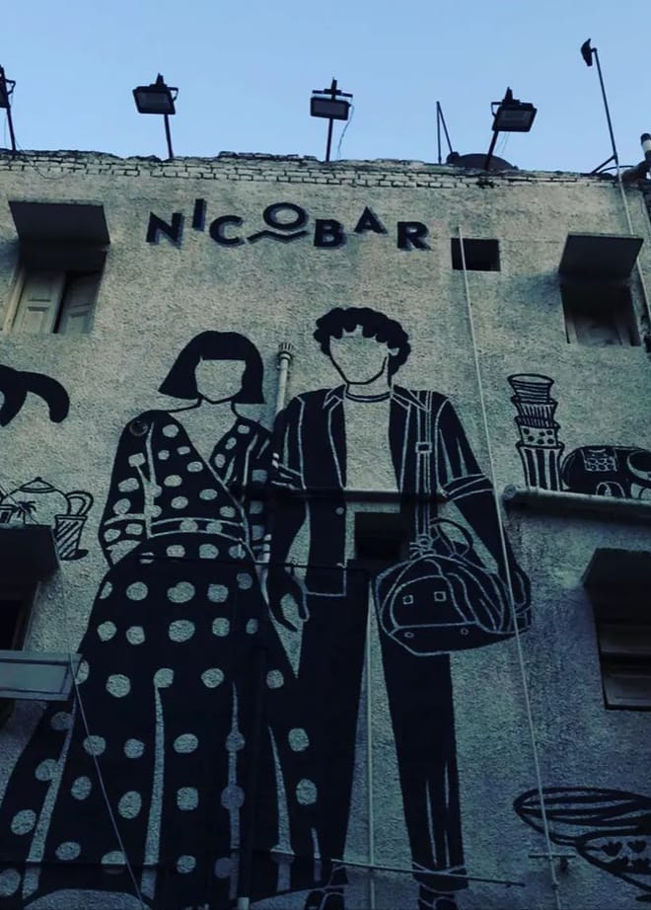
Types of Recommendations
Diverse Suggestions
offers a wide array of recommendations
Accommodations: From boutique hotels to cozy vacation rentals
Activities: Adventure, cultural, or relaxation – find the perfect activity for your trip
Dining: Discover local flavors and hidden culinary gems

Slide 8
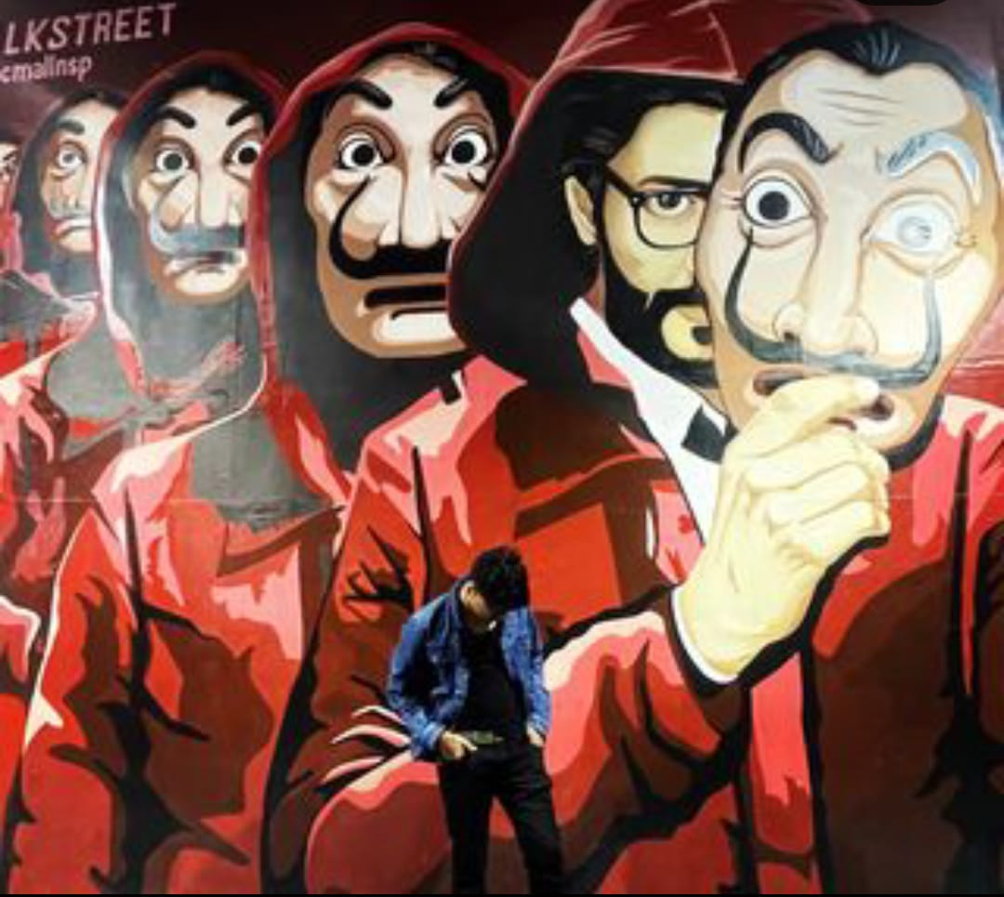
Testimonials
Hear from Our Travelers
"A truly personalized travel experience! made our trip unforgettable."
"The recommendations were spot-on, reflecting our interests and preferences perfectly."
Real testimonials from our satisfied users

Slide 9
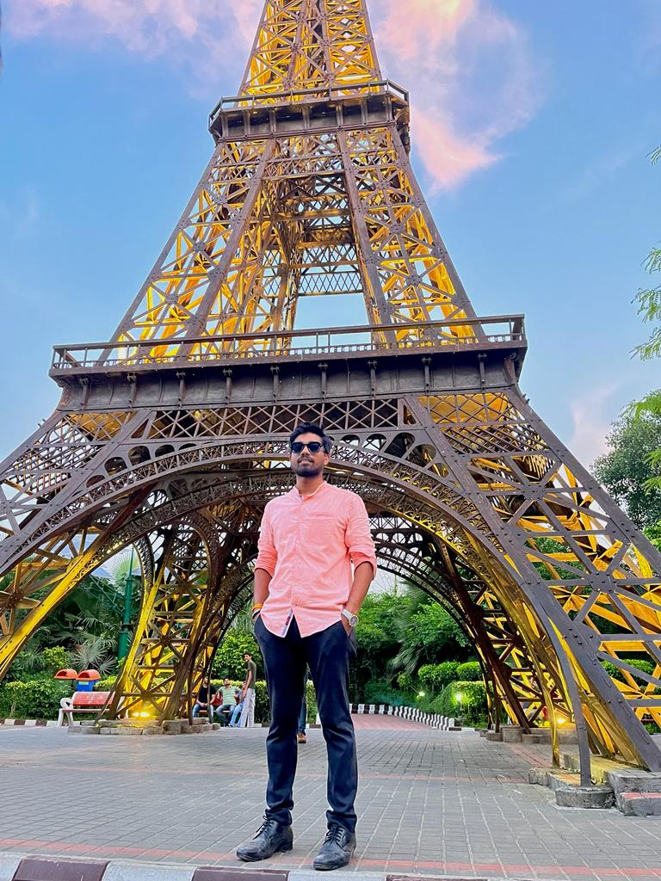
Case Studies
Real-World Success Stories
Case Study 1: "Family Adventure in "
Personalized recommendations led to a seamless family vacation, creating lasting memories
Case Study 2: "Solo Explorer in "
A solo traveler's journey enriched by tailored suggestions, discovering the essence of the destination

Slide 10

Future Developments
What's Next
Exciting developments on the horizon
Improved recommendation algorithms for even more accurate suggestions
Integration of new features to enhance your overall travel experience

Slide 11

Slide 10: Get Started Today
Start Your Journey
Ready to embark on a personalized travel adventure?
Sign up today and experience the magic of tailored recommendations

Slide 12
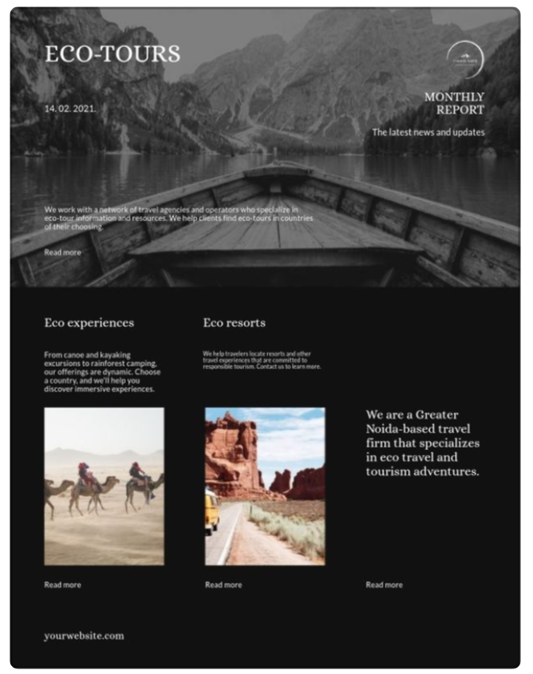
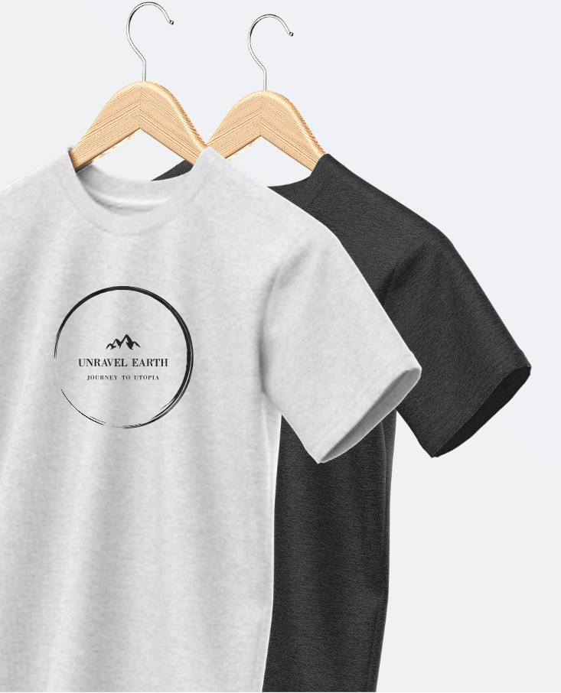

Blogs and Merchandise

